Slide 1

It's Time to Get Started with
Linux Forensic Analysis

Slide 2


Mariam Khader
Ali Hadi
Assistant Professor, Computer and Digital Forensics, Champlain College
Research Lead, Leahy Center for Cybersecurity and Digital Forensics
Interests: DFIR, Cybersecurity and Data Science
@maryst33d
Associate Professor and Program Director, Computer and Digital Forensics, Champlain College
Research Director, Leahy Center for Digital Forensics and Cybersecurity
Co-Founder and CTO, Cyber5W
Interests: DFIR, Adversary Simulation, and Offsec
@binaryz0ne

Slide 3
Overview
Session #1:
01
Get to know the case
Overview of the Linux OS
Preparing your Environment
Verification and Adding the Evidence
Session #2:
02
Mounting the File System
System Navigation and Timezone
Users, Groups, Permissions, etc
Checking System Logs
Session #3:
03
Working with The Sleuth Kit (TSK)
Data Recovery / File Carving
Finding how the threat actor gained access.

Slide 4

Why Linux Forensics
Malicious actors are increasingly targeting Linux-based operating systems due to their widespread use in public cloud workloads. Operating on 90% of public cloud computing tasks in 2017
In the first half of 2021 alone, Trend Micro reported over 13 million attempted malware attacks against Linux systems.
https://www.trendmicro.com/vinfo/us/security/news/cybercrime-and-digital-threats/linux-threat-report-2021-1h-linux-threats-in-the-cloud-and-security-recommendations

Slide 5
Web Server Case Brief...
Web Server Environment (Apache)
Web Application (drupal)
Used for local team
Unusual activity was noticed during last week (2nd week of Oct. 2019)
The presentation will walk through the cases covered and where to focus and why, in other words (learning while investigating)...
Also answer the questions we provided in the workshop!

Slide 6
Basic Commands
pwd
mkdir
cd
Print current working directory
ls -lha
Create a new directory. How to create a file?
cp
Change your current working directory
List current files and directories
Copy a file. How to move a file?

Slide 7

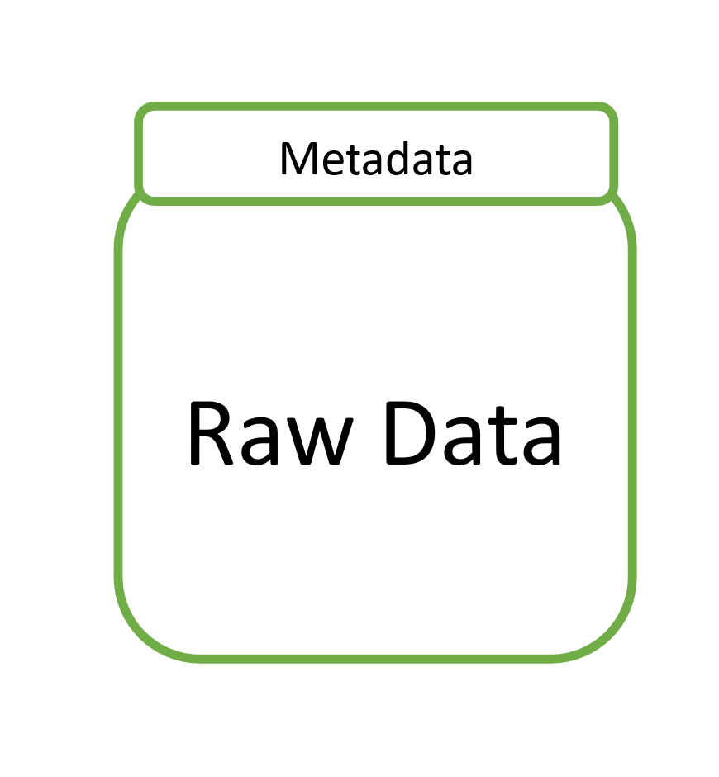
E01 images
Forensic Images
dd (Raw) images

Slide 8
EWF-Tools
ewfinfo
ewfverify
ewfacquire
ewfmount
Extract the metadata stored inside the image
Calculate the correct hash value of the E01 image
Acquire an E01 image of the evidence
Used to mount the Raw Data to the current system
ewfinfo
ewfverify
ewfacquire
ewfmount

Slide 9
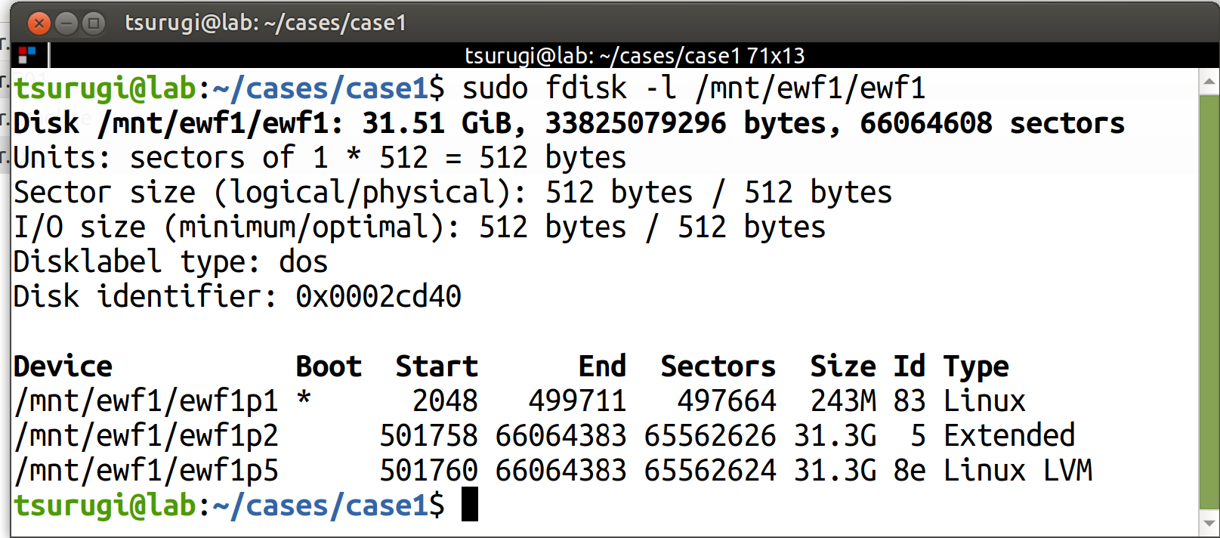
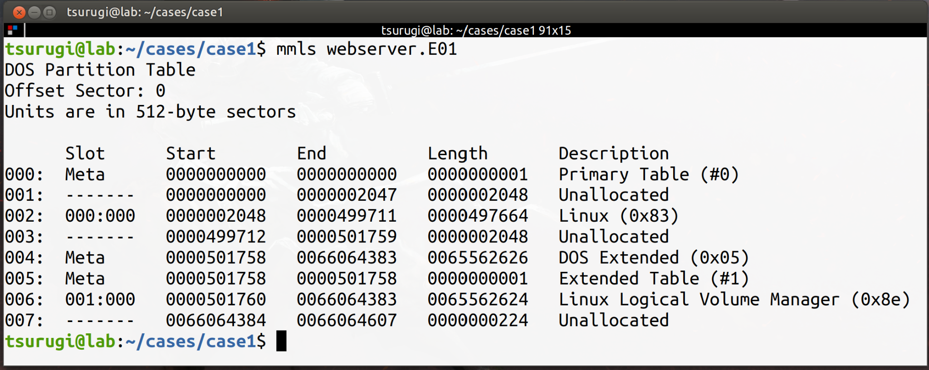
Display layout of partitions
fdisk -l
mmls
fdisk -l
mmls

Slide 10
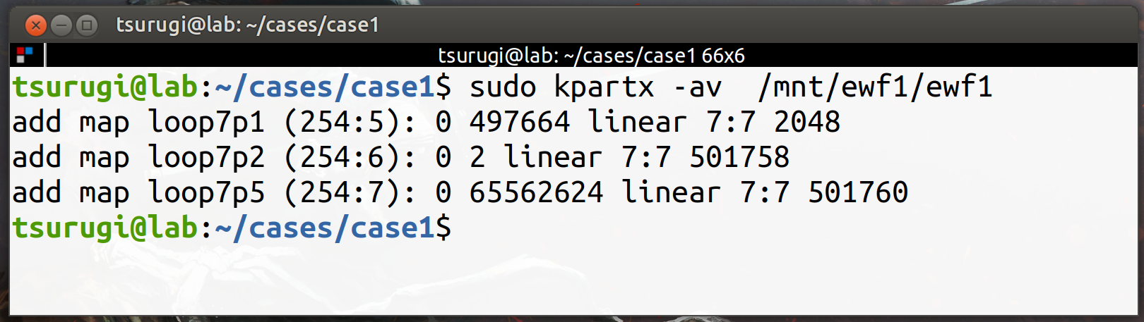
Using Kpartx to work with forensic (virtual) images

Slide 11
lvdisplay
“lvdisplay shows the attributes of LVs, like size, read/write status, snapshot information, etc.”
pvs
“Provides physical volume information in a configurable form, displaying one line per physical volume”
Notes:
https://access.redhat.com/documentation/en-us/red_hat_enterprise_linux/4/html/cluster_logical_volume_manager/physvol_display#:~:text=The%20pvs%20command%20provides%20physical,%E2%80%9CCustomized%20Reporting%20for%20LVM%E2%80%9D.

Slide 12
Let’s Find What Happened!
-hands-on time-

Slide 13
Session 2

Slide 14
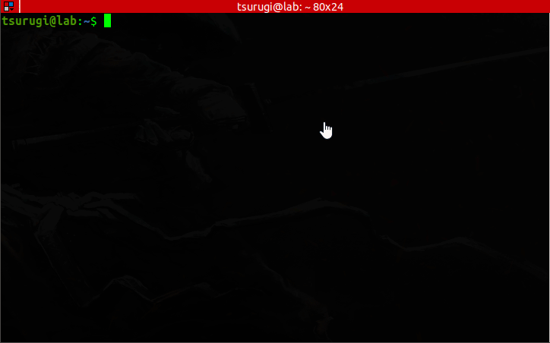
File Hierarchy Standard
Everything in Linux is a file, and all files exist under the root directory, “/”.

Slide 15

TSK Tools
fs stat
mm ls
f ls
mm stat

Slide 16
Evidence Mounting
1
Search might tamper evidence ...
find→ stat()
Disable FS atime:
Option #1:
$ sudo mount -o remount,noatime /dev/….
Option #2:
$ mkdir /mnt/extdrv/rootvol
$ rootvol=/mnt/extdrv/rootvol
$ sudo mount --bind / $rootvol
$ sudo mount -o remount,ro $rootvol
2
SECURITY

Slide 17
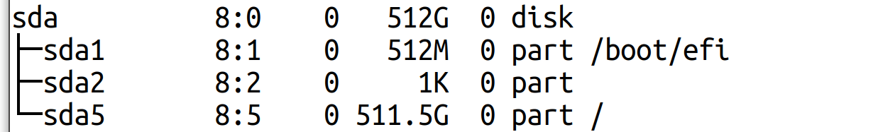
Mounting
read only
noatime
noload
noexec
SECURITY

Slide 18
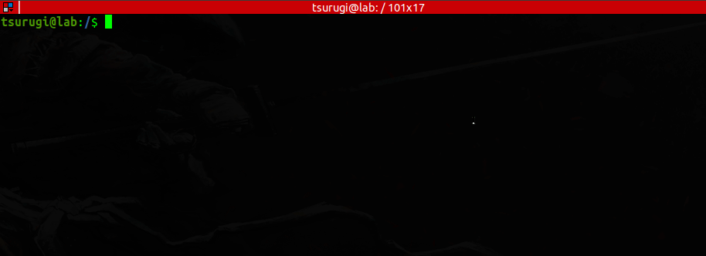
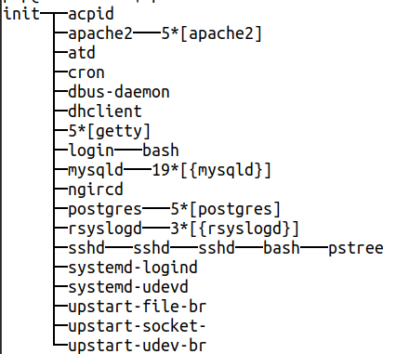
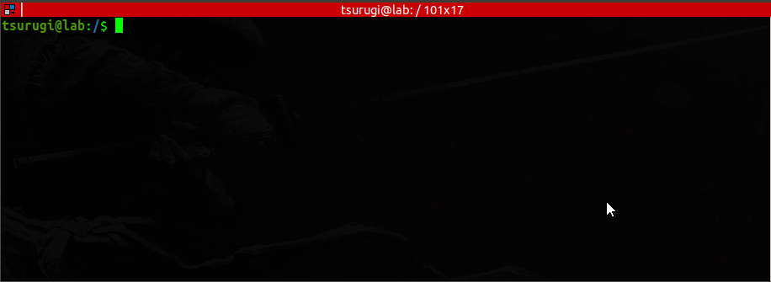
Processes Tree...
Mounted
Dev/Vol...
Old Linux Systems…
Notes:
# pstree
# findmnt -kR

Slide 19
More Linux Commands
strings
file
xxd
…
cat
…
less
.
.
.

Slide 20
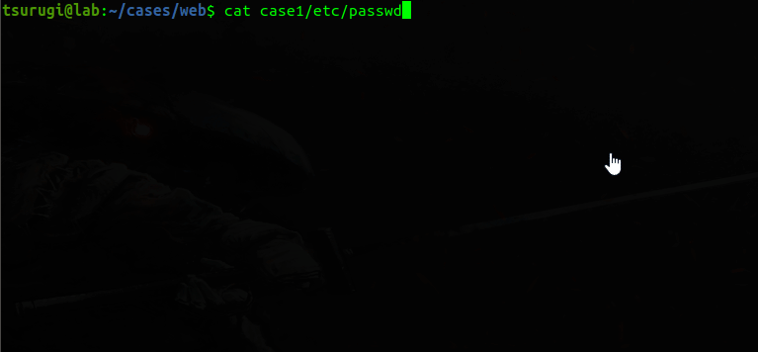
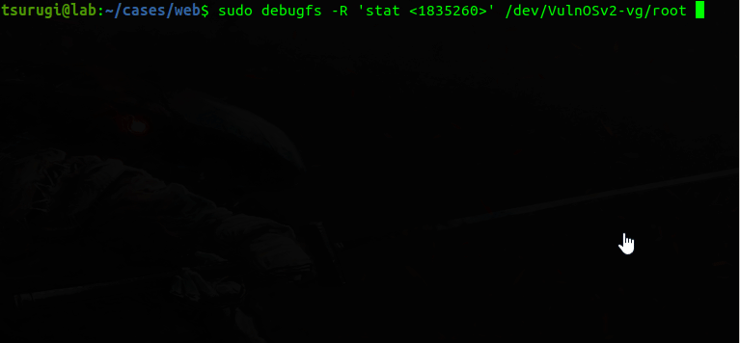
Hunt Users...
Checking for suspicious user account entries…
$ cat /etc/passwd
Timestamps using debugfs
$ sudo debugfs -R 'stat <1835260>' /dev/…..
Notes:
Live
Two suspicious entries:
No such thing for a php user!
The system’s mail account has been modified to allow logins, it should have a nologin shell

Slide 21
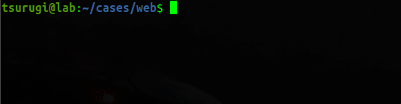
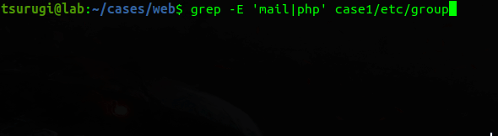
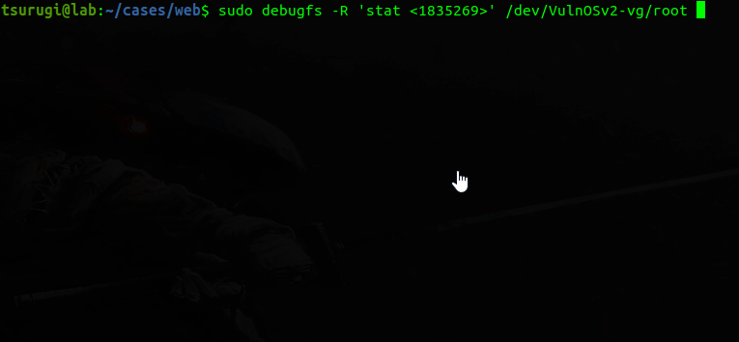
Hunt Groups...
Checking for suspicious group entries…
$ tail -n 4 /etc/group
$ grep -E ‘mail|php’ /etc/group
Timestamps using debugfs
$ sudo debugfs -R 'stat <1835269>' /dev/…..
Notes:
Live/Offline
# stat /etc/group
# used debugfs for offline stats
# sudo debugfs -R 'stat <1831425>' /dev/sda2

Slide 22
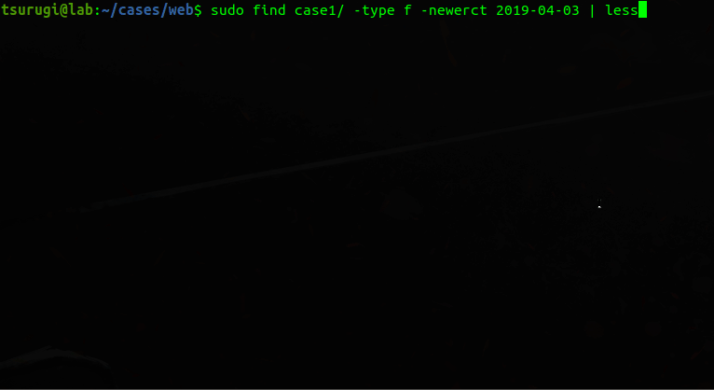
File Hunting...
Searching for files that have been changed after a certain date …
$ find case1/ -type f -newerct 2019-04-03 | less
Notes:
Or with elevated priv
# sudo find / -ctime +1 -ctime -5
ctime = last time the metadata changed - ie., chmod, chown, etc.
atime = last time the file was accessed (read)
mtime = last time the file was written, or open append and closed without writing
The easiest way to remember which is which is to read their alphabetical order:
Atime can be updated alone
Ctime will update atime
Mtime will update both atime and ctime.
http://wisercoder.com/knowing-difference-mtime-ctime-atime/

Slide 23
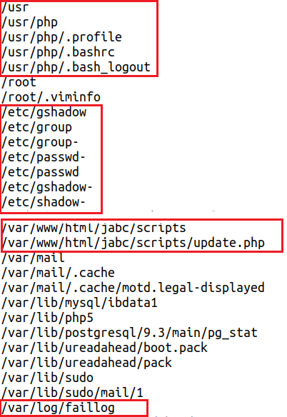
File Hunting...
home dir?
IR: Searching for files that had their metadata changed within the last 5 days…
$ find / -ctime +1 -ctime -5
Expected based on prev. analysis
What’s this?
Failed login attempts?
Notes:
Or with elevated priv
# sudo find / -ctime +1 -ctime -5
ctime = last time the metadata changed - ie., chmod, chown, etc.
atime = last time the file was accessed (read)
mtime = last time the file was written, or open append and closed without writing
The easiest way to remember which is which is to read their alphabetical order:
Atime can be updated alone
Ctime will update atime
Mtime will update both atime and ctime.
http://wisercoder.com/knowing-difference-mtime-ctime-atime/

Slide 24
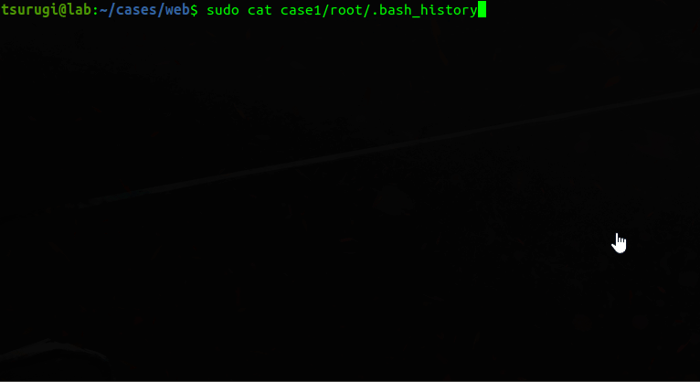
Hunt CLI History...
Checking user .bash_history file for commands executed (+order of execution)...
Notes:
# history
Or using TSK icat with .bashrc
# icat image inode
If we just Google for 37292.c we find that its: https://www.exploit-db.com/exploits/37292
So this is how the threat actor probably gained root

Slide 25
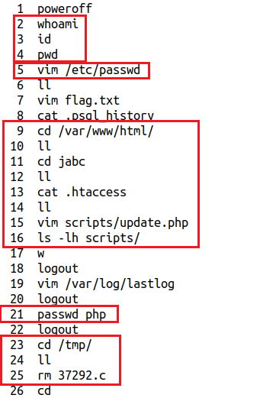
Hunt CLI History...
Basic compromise checks
Why vim to passwd?
IR: Checking user .bash_history file for commands executed (+order of execution)...
$ history
Web dir?
Password changed?
What’s 37292.c ??!!
(check it later)
Notes:
# history
Or using TSK icat with .bashrc
# icat image inode
If we just Google for 37292.c we find that its: https://www.exploit-db.com/exploits/37292
So this is how the threat actor probably gained root

Slide 26
Log Files
syslog
auth.log
btmp
wtmp

Slide 27
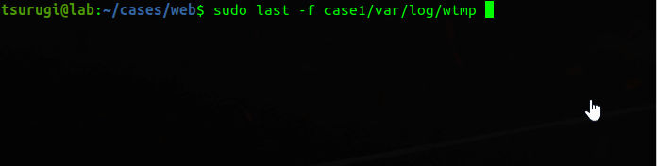
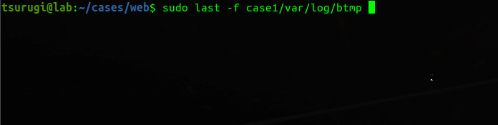
Hunt Last Logged Users...
OR? Use debugfs...
Could be checked on a live system using:
$ last
$ w
$ lastlog
$ sudo last -f /var/log/wtmp
$ sudo lastb -f /var/log/btmp
Notes:
last -f /var/log/wtmp

Slide 28
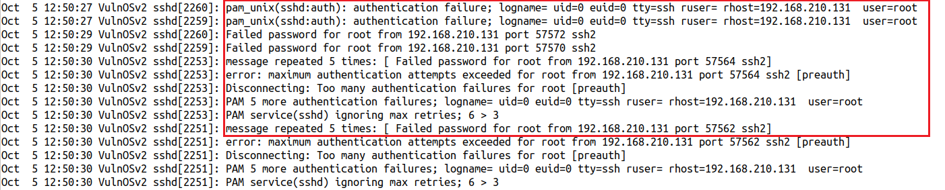
Hunt Failed Logins...
Bruteforce activity ...
Checking for failed logins in the auth.log file…
$ sudo cat /var/log/auth.log
But was it successful?!!!
Notes:
We find many login attempts, but if we continue searching the file, we won’t find a successful access using bruteforce..

Slide 29
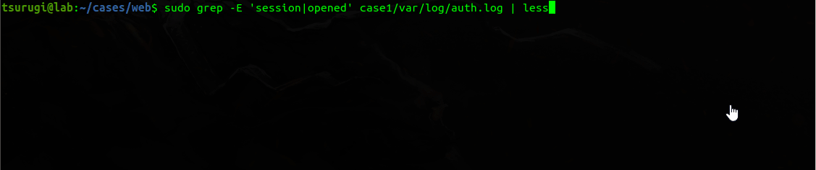
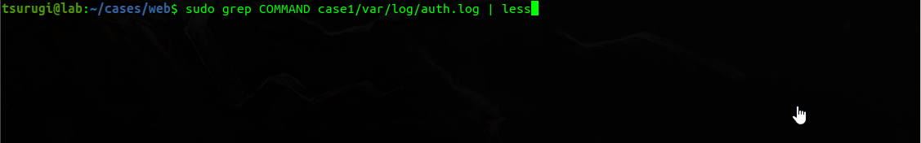
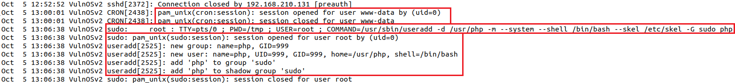
More Login Hunting...
UID 0 for Web?!!!
Digging further reveals that
our Apache user account
(www-data) opened a
session by root (uid=0)!
Then, useradd is used to add ‘php’ account to system with:
Homedir → /usr/php
Default shell → /bin/bash
Copied skeleton files from → /etc/skel
Added account to sudo group
Notes:
Could also use grep and search for adduser|useradd|groupadd , etc...

Slide 30
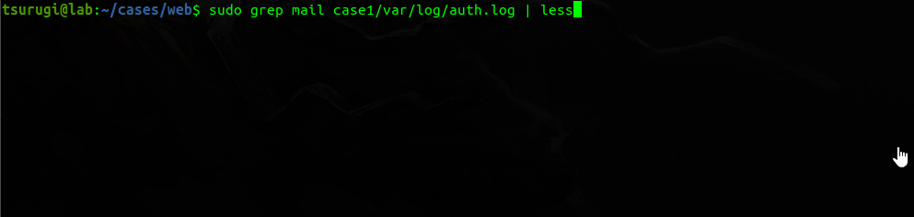
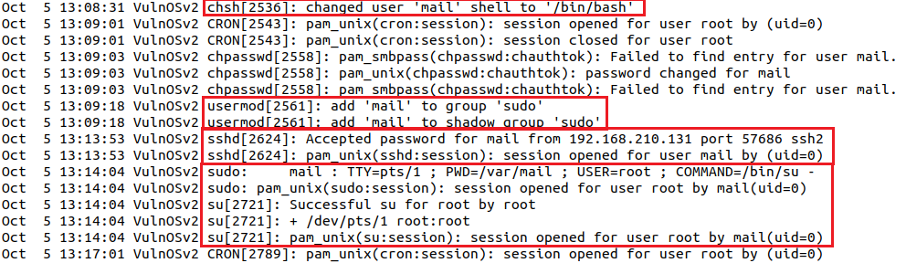
And the Hunt Goes On...
‘mail’ account changes and first time login!
Continuing the search within the auth.log file we find more answers to our Q(s)...
Changed ‘mail’ account’s shell from nologin to /bin/bash
Added ‘mail’ account to the sudo group
First time we see ‘mail’ login and it was through ssh
‘mail’ switches to user ‘root’

Slide 31

ext4magic
Data Carving
debugfs

Slide 32
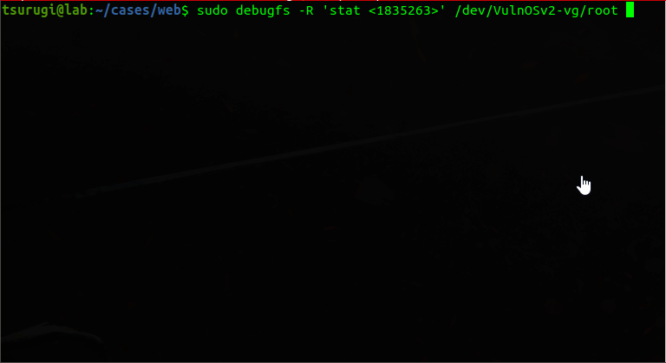
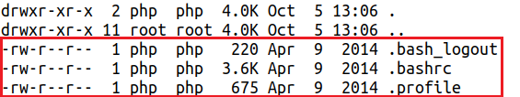
Hunt Suspicious Dir...
The /usr/php directory details...
$ sudo debugfs -R 'stat <1835263>' /dev….
Directory contents…
$ ls -lhat /usr/php
Notes:
# sudo debugfs -R 'stat <1835263>' /dev/VulnOSv2-vg/root
Seems the home directory of our suspicious user “php”

Slide 33
Hunt Last Logged Users...
Dump the contents of wtmp / btmp:
$ sudo debugfs /dev/…...
debugfs: cd /var/log
debugfs: ls
debugfs: imap <524275>
debugfs: dump_inode wtmp /media/extdrv/case/wtmp.dump
Now we can do:
$ last -f wtmp.dump
debugfs command prompt...

Slide 34
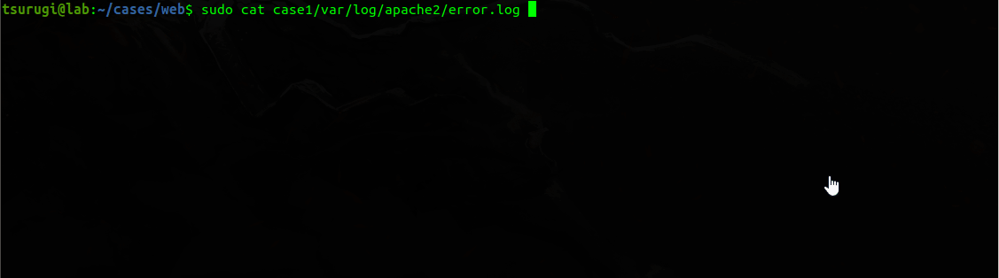
Hunt Actor’s IP Address...
Apache’s error.log...
Searching through the error.logs file for our threat actor’s IP address “192.168.210.131”...
Found some unusual entries:
Weird long string of chars (probably BASE64)...
The added file ‘update.php’ was accessed but has errors…
The PHP “system” function was invoked but with errors too..
Notes:
sudo awk '{print $1}' apache2/access.log | sort | uniq -c | sort -nr | head -n 10
sudo grep '192.168.210.131' apache2/access.log

Slide 35
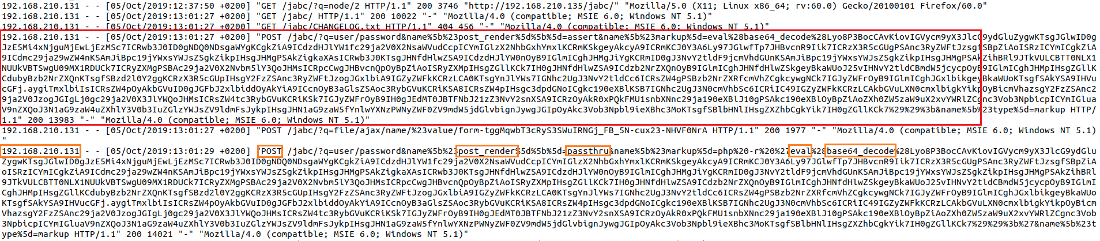
Hunt Actor’s IP Address...
Apache’s access.log...
Big blob of chars sent in POST request!
Findings here:
Threat actor sent big string (blob) of chars using POST method ...
PHP functions being called: passthru, eval, and base64_decode !!!
Is this a SQL injection or what?
Let’s decode this string...
Notes:
sudo awk '{print $1}' apache2/access.log | sort | uniq -c | sort -nr | head -n 10
sudo grep '192.168.210.131' apache2/access.log

Slide 36
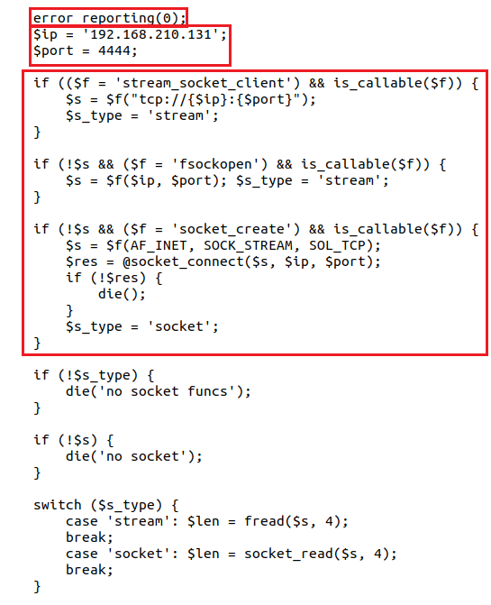
Decoding Suspicious String...
Meterpreter RevShell !!!
Turned off!
After decoding and home cleaning:
$ cat post-string.txt | base64 -d
Call home IP+Port
Creating the communication socket
Notes:
sudo awk '{print $1}' apache2/access.log | sort | uniq -c | sort -nr | head -n 10
sudo grep '192.168.210.131' apache2/access.log

Slide 37
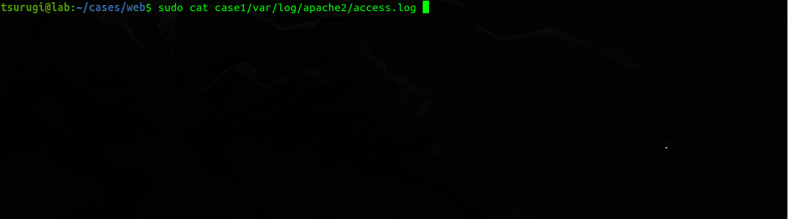
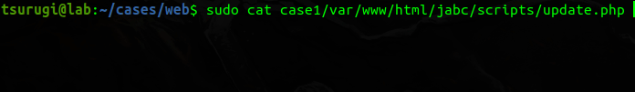
What about update.php?...
More access logs...
More digging into the access logs file, revealed the following:
Huh!.. Webshell?!
$ cat case1/var/www/html/jabc/scripts/update.php
system() function being used...
Notes:
sudo awk '{print $1}' apache2/access.log | sort | uniq -c | sort -nr | head -n 10
sudo grep '192.168.210.131' apache2/access.log

Slide 38
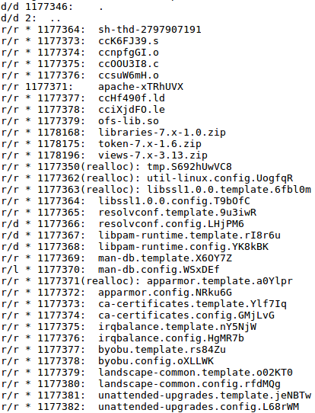
What about 37292.c File?...
Googling → probably an exploit!!!
Searching directory file was found in, leads to nothing!
File was in /tmp, but nothing there now (deleted)...
We only have one file there undeleted…
apache-xTRhUVX
* deleted entries!

Slide 39
Dump the Journal!!..
EXT4 = journaling fs...
If we check using TSK, since it’s an EXT4 fs, then even if we know what name it had, then still we can’t access the content, since its entry will be zeroed out!
No longer capable of accessing the file…
Also, if we check those * files, we will also get zero output!
No metadata available that leads to the file...
We could try dumping them out in two steps:
Dump the EXT4 journal
Use ext4magic for recovery

Slide 40
Get them Back!!..
Step1: debugfs
$ sudo debugfs -R ‘dump <8> ./journal’ /dev/….
dump → option used to dump a file using inode #
8 → inode # of the EXT4 journal
Step2: ext4magic
$ sudo ext4magic -a DATE -b DATE -j ./journal -m -d output/
a and b are used to specify date after and before...
j for the journal...
m try to recover all deleted files...
Sift through output dir...

Slide 41
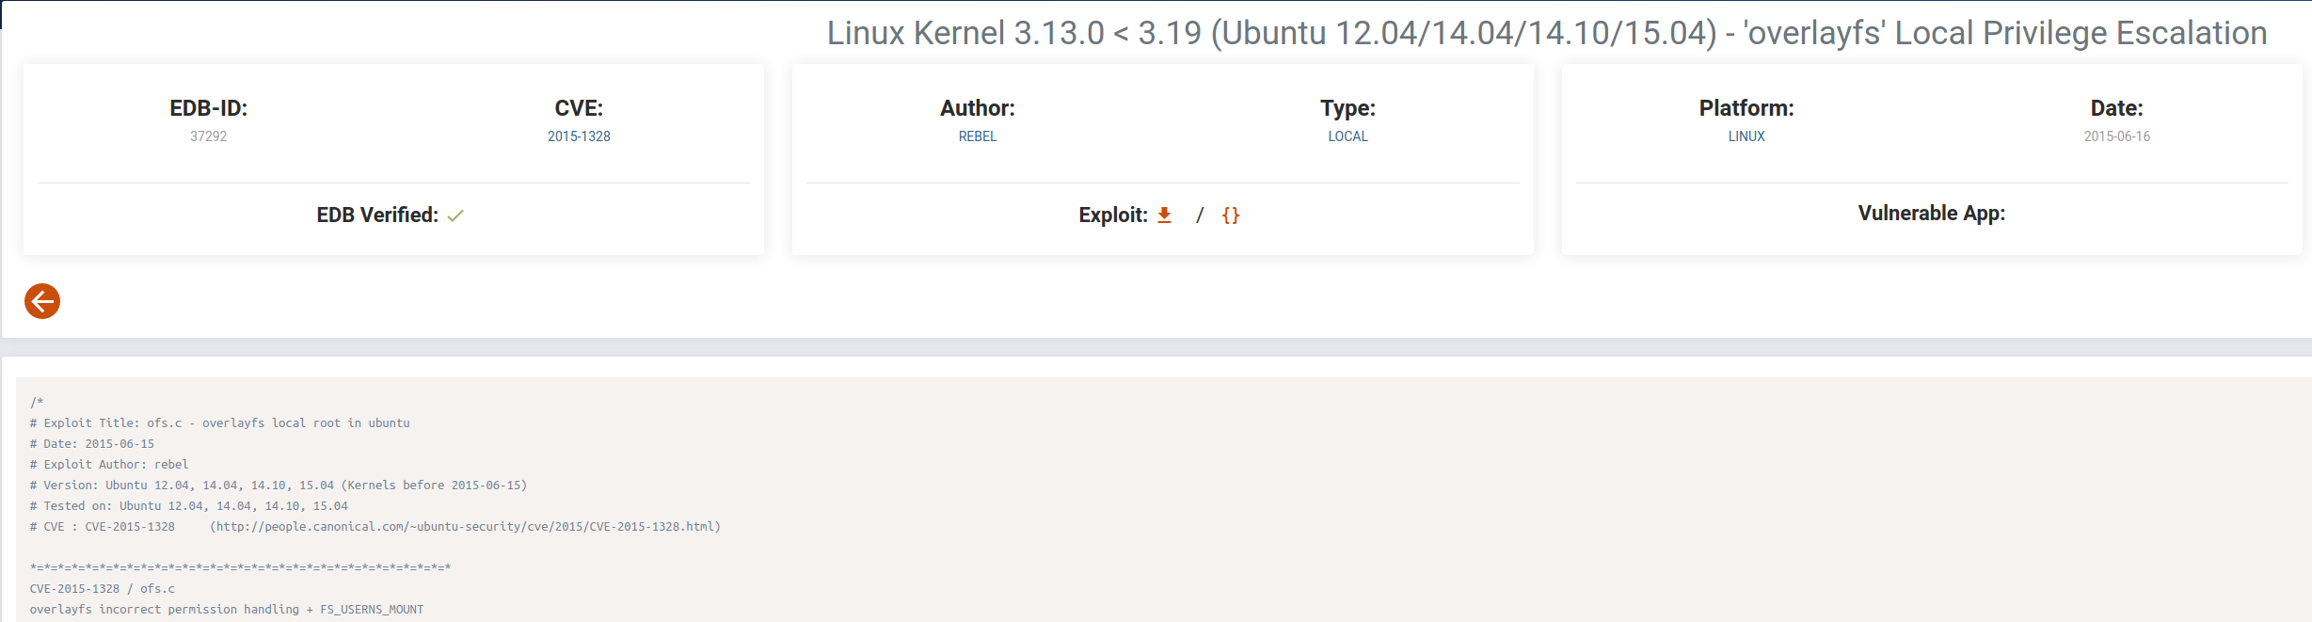
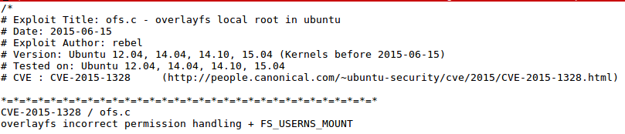
Comparing...
Exploitdb vs. ext4magic
Exploitdb…
Ext4magic...

Slide 42
Story of Case #1...
User php added to the system
System user ‘mail’ was modified and given access to the system
PHP webshell was added
Bruteforce was unsuccessful
Compromised using vulnerable web application (drupal CVE-2018-7600)
Privileges were escalated using Kernel vulnerability (CVE-2015-1328)

Slide 43
Summary of What to Do!!!...
Gather as much case info as you can ...
Understand the FHS ...
Check user /etc/passwd and group accounts /etc/group
Check shells and history logs
Search added/modified files …
Check running processes, locations, and configs ...
Grep your way through logs, they are your friend ...
Run timelines …
Finalize your report ...

Slide 44
😃
thanks!
Any questions?
send them our way
@binaryz0ne & @maryst33d

Slide 45
Credits & References...
Special thanks to all the people who made and released these awesome resources for free:
Tsurugi Linux Team, @tsurugi_linux
Presentation template by SlidesCarnival
Photographs by Unsplash
More Linux DFIR, linuxdfir.ashemery.com
Sorry if we missed someone!

